Slide 1


The Purpose of the Process: Perseverance
Virginia Family Camp 2026

Slide 2
The Question:
"Why did God create a system where the process of perseverance would be needed and essential?"
The Choice
The Wiring
The Warning
Why did God give us choice and not hardwire at least part of the process?
God created our biology to reinforce our choices.
Pitfalls are designed to rewire us for instant gratification — the enemy of perseverance.

Slide 3
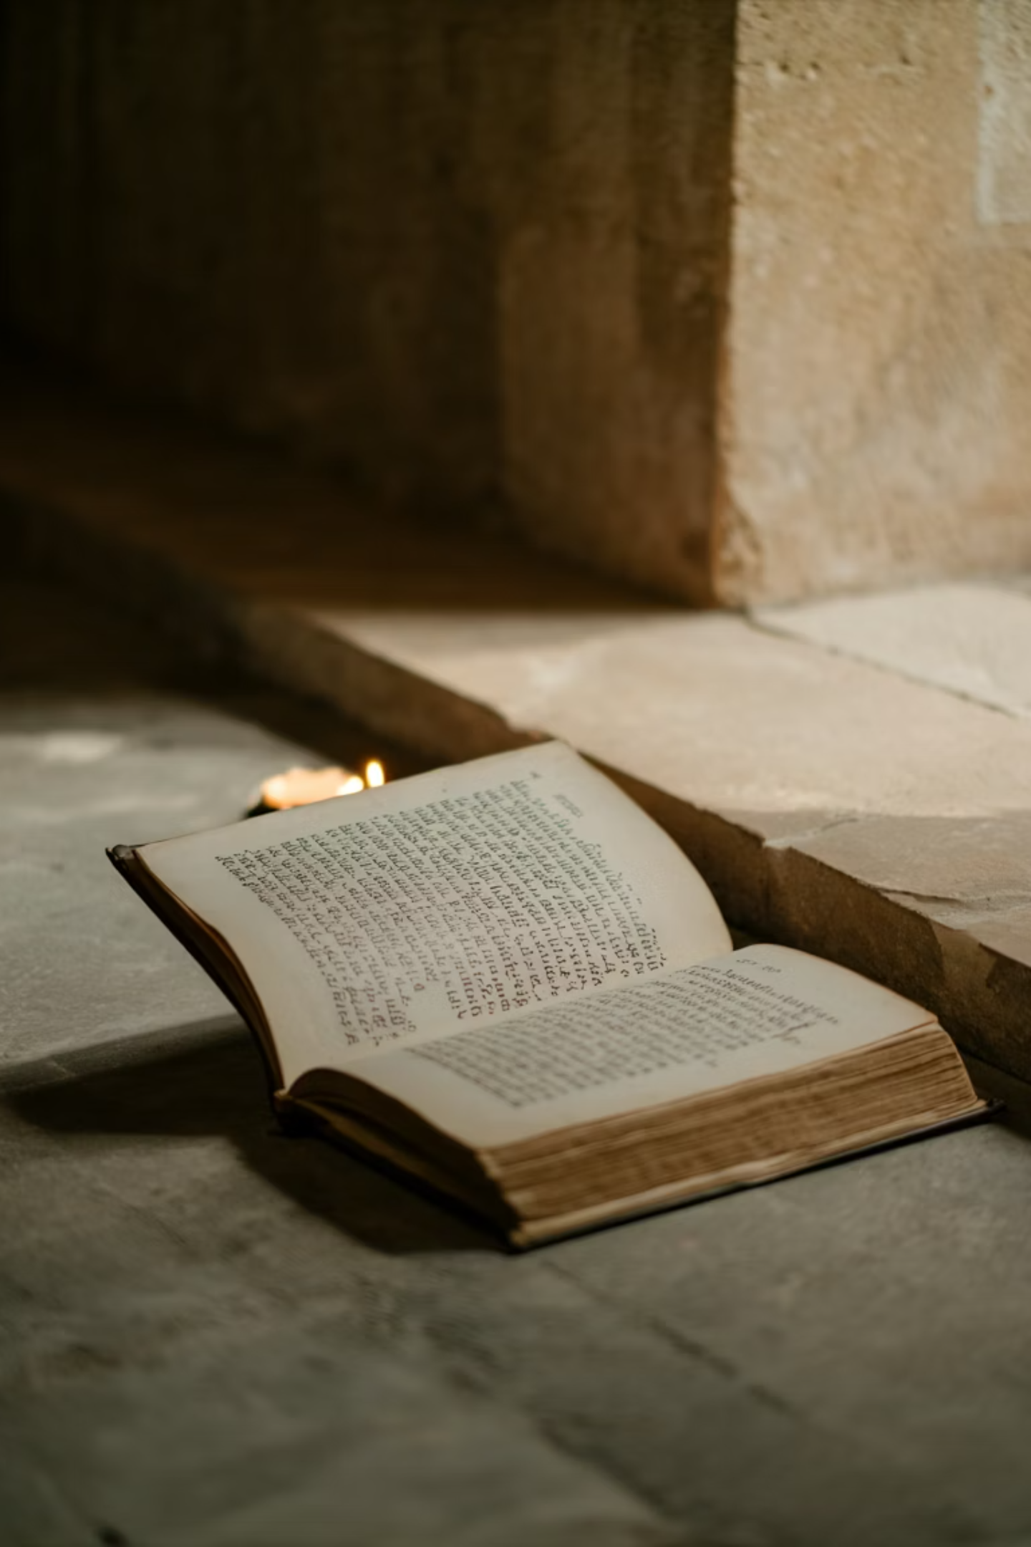
The Parsing: 14 Words, 120–160 Times
God spends an extraordinary amount of language on perseverance. The primary word — ὑπομονή — means to remain under- but remain under what?

Slide 4
The Internal Struggle
The term θλῖψις refers to pressure, constriction, and a narrow place where every instinct says get out.
The Situation
Our Internal Reaction
The Training
This is the external tribulation, the pressure, constriction, and narrow place itself.
Panic comes from within, not from the situation itself. The problem is our internal reaction to confinement and restriction.
We learn to handle pressure by staying under it and being trained by it.

Slide 5
The Cost of Confession
Two powerful examples of perseverance under ultimate pressure:
THE MARTYR'S CHOICE
CHRIST'S CHOICE
Could offer incense to Caesar and pretend
Could return to serving Christ afterward
But our confession means something
Could have turned off all pain during torture
Could have justified it: "I'm still dying for them"
But He endured the full weight of suffering
How do you develop the perseverance? By staying under prior tribulation and learning how to deal with the anxiety and panic it produces by trusting in the Lord and casting our cares upon Him.

Slide 6
The Other 13 Words for Perseverance
μακροθυμία: Adds patience toward difficult people, not just circumstances.
προσκαρτερέω: Adds intentional devotion and persistence in practice (you keep showing up).
ἐπιμένω: Adds continuing in a state or path over time (staying in something).
μένω: Adds abiding or remaining as a settled condition, not just enduring pressure.
στήκω: Adds standing firm in position, resisting movement or compromise.
ἀνέχω: Adds bearing with others, tolerating friction relationally.
ὑποφέρω: Adds carrying a burden under strain, emphasizing weight-bearing.
καρτερέω: Adds inner toughness/fortitude, a strengthened resolve.
ἀγωνίζομαι: Adds active striving or struggle, not passive endurance.
τηρέω: Adds maintaining/guarding something over time (holding a standard).
κρατέω: Adds gripping tightly so as not to lose, forceful retention.
κατέχω: Adds holding fast/retaining firmly, often internal or doctrinal grip.
βεβαιόω / βέβαιος: Adds firmness/established stability, the result of perseverance.

Slide 7
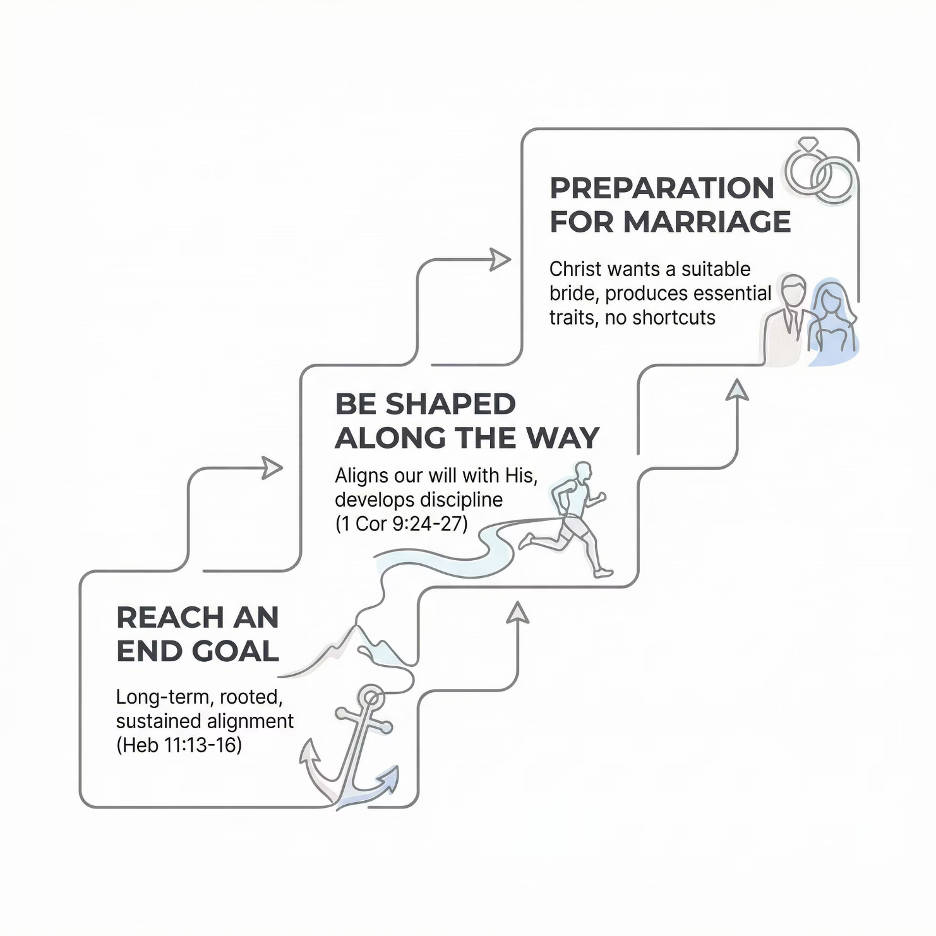


The Purpose
No Shortcuts
Perseverance in all aspects of Christian life produces traits that are impossible without it. Christ wants a bride suitable for Him — and that is what our growth is supposed to produce.
"There are no shortcuts to true growth in Christ. That's why we need to be aware of the pitfalls that offer them."

Slide 8
The Five Mechanisms God Designed
NEUROPLASTICITY
Strengthening active pathways, weakening unused ones through experience
MYELINATION
Insulation of neurons makes practiced behaviors faster and more automatic
DOPAMINE SYSTEM
Designed for pursuit of meaningful goals—a little dopamine after bigger effort
PREFRONTAL CORTEX
Governs discipline, restraint, and future-oriented thinking
HABIT LOOPS
Cue → Behavior → Reward. Once established, behaviors run with minimal resistance

Slide 9
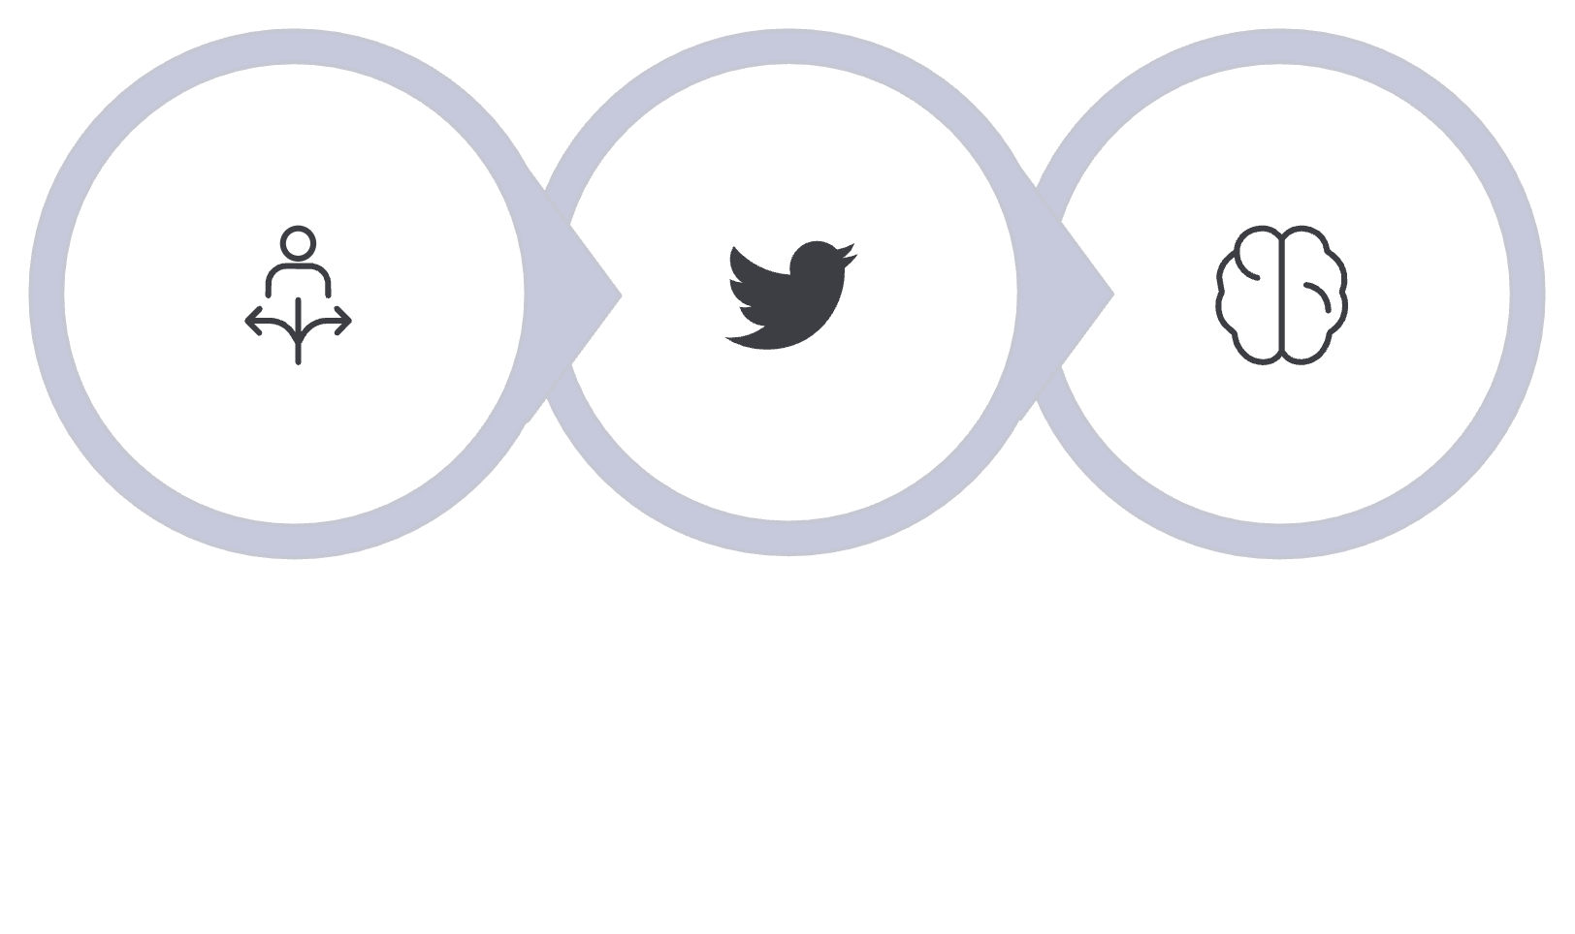
Proactive Effort Creates a More Automatic Reality
This Is Sanctification
God designed it this way: "Proactive and intentional effort creates a more automatic reality." Sanctification is cumulative — not always having to face every sinful thing forever.
We have a choice to make, now and always, as to who we are going to be.
Biology reinforces the will, not the other way around.
Will Chooses
Holy Spirit Empowers
Biology Reinforces

Slide 10
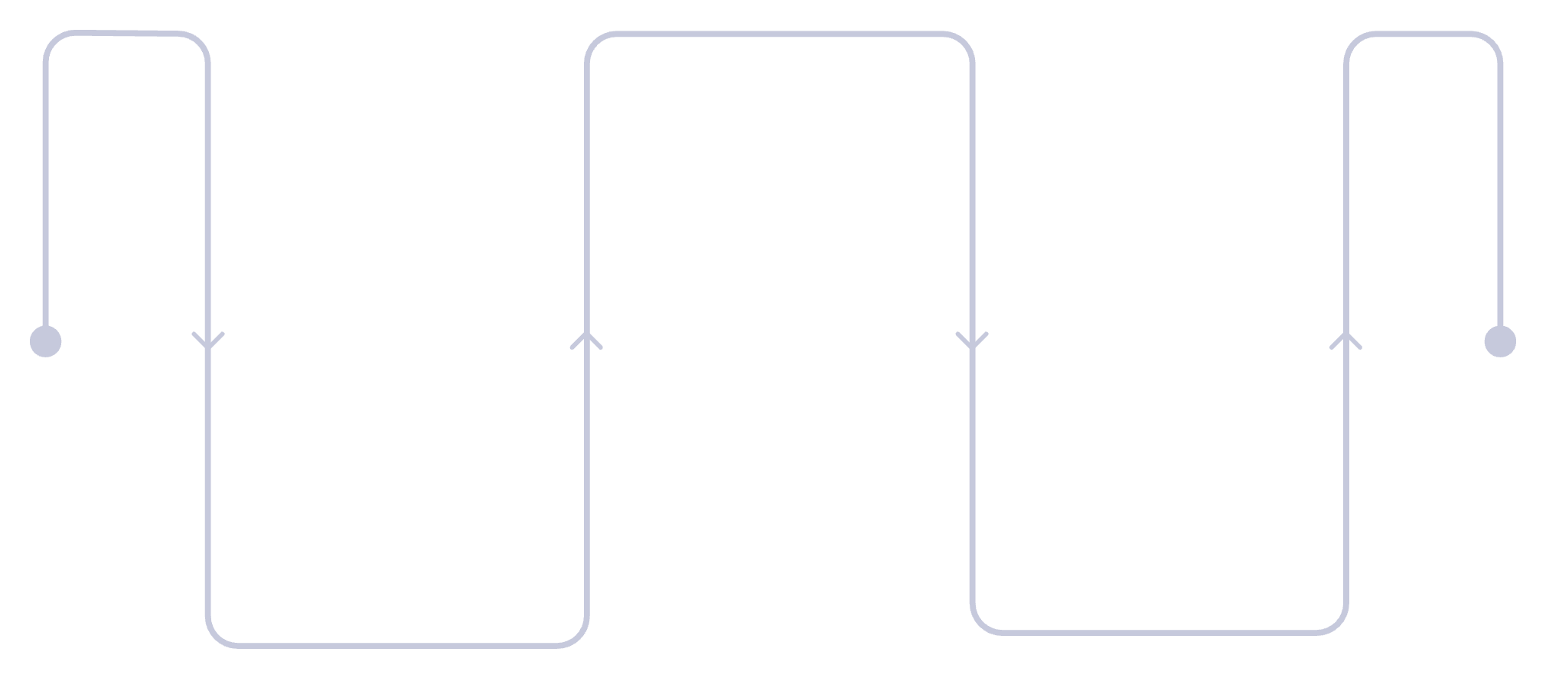
Current Effort Trains the System That Makes Future Effort Easier
Key insight from Andrew Huberman about the anterior midcingulate cortex (aMCC):
The aMCC is stronger and sometimes larger in people who habitually do tasks they don't want to do
When you choose difficulty, you literally strengthen the part of your brain that helps you choose difficulty again
The Cycle of Effort
Strengthen aMCC
Repeated effort builds the circuit
Choose Difficulty
Future Difficulty Easier
Opt for a challenging task
Tasks feel less demanding over time

Slide 11

The Pitfalls
Are There Acceptable Addictions in the Church?
"By what a man is overcome, by this is he enslaved." — 2 Peter 2:19
Technology & Social Media
Dopamine Tolerance
Designed to be addicting. Internal Meta docs: "IG is a drug… we're basically pushers." YouTube goal: "not viewership — viewer addiction."
Meta's own emails warned reward tolerance was rising so high that users "can't feel reward anymore." The conversation ended: "It's kind of scary."
AI & What's Coming
Over-reliance on AI risks cognitive atrophy — reducing the mental effort required to think critically, learn, and remember. Social media has nothing on AI.

Slide 12
The Evidence: What Tech Companies Admit
YOUTUBE- on becoming the new digital babysitter:
META
LAWSUITS
"Oh my gosh y'all, IG is a drug."
Meta and Google just lost lawsuits on this
"How are we measuring wellbeing? We're not."
Response: "Lol, I mean all social media. We're basically pushers."
More than 20 trials ongoing
"The goal is not viewership, it's viewer addiction."
Email about reward tolerance: "People can't feel reward anymore" (dopamine)
Conversation ended: "It's kind of scary."

Slide 13
How Tech Hijacks God's Mechanisms
NEUROPLASTICITY
High-frequency, low-effort behaviors dominate through repetition. Creates "I Can't Even" syndrome.
MYELINATION
Fast, shallow behaviors become automatic and preferred. Instant reaction, not sustained effort.
DOPAMINE
Constant easy reward from novelty and likes. Long-term perseverance feels unrewarding.
PREFRONTAL CORTEX (discipline) vs AMYGDALA (emotional and impulsive)
Amygdala constantly overstimulated. PFC undertrained, especially in children.
HABIT LOOPS
Cue: boredom → Behavior: scroll → Reward: dopamine. Competes directly with perseverance loops.

Slide 14
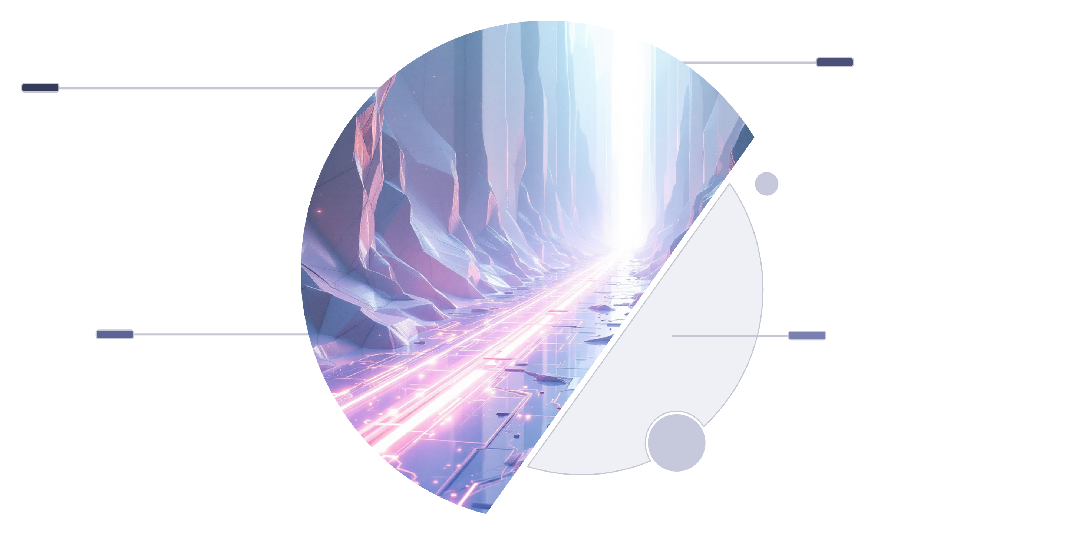
The Danger of Two Competing Pathways
What happens when we vacillate between righteousness and sin?
Immediate Reward
Spirit-Led Renewal
Choose renewal, gain sustained strength
Seek quick pleasure, short victory
Disciplined Response
Old Man Conflict
Reactive patterns, escalating struggle
Delay Impulses, build new habits

Slide 15
Why Each Relapse Matters
Intermittent reinforcement makes the old habit harder to break.
WHAT HAPPENS WITH EACH RELAPSE:
WHY GOD IS SO ADAMANT:
Reactivates old pathways
Re-myelinates old firing patterns
Re-links reward cues
Makes it easier to return next time, especially under stress
"Stop sinning"
"No one who is born of God practices sin"
"Lay them all aside"
"Therefore putting aside all filthiness and all that remains of wickedness"
"Perfecting (completing) holiness in the fear of God"
THE REASON: The more we reinforce the old ways, the harder they are to break.

Slide 16
The Danger of Two Competing Pathways
THE RESULT
Internal conflict remains high (Double-minded)
Neither pathway fully dominates
Temptation feels persistent and strong
Divided mind with divided loyalties
You become a Romans 7 person
This continuous struggle without clear commitment leads to a state of perpetual internal conflict, hindering true spiritual growth and perseverance.

Slide 17
What Breaks the Cycle: Consistency
WHY THIS WORKS:
God designed it this way
Scripture's focus on repeated action to put away the deeds of the flesh
This is the biological reality of sanctification
THE TIMELINE:
Research shows ~66 days to build a habit so it's automatic. But this depends on:
How ingrained the old habits are
How often you do them
The strength of competing pathways
THE GOOD NEWS:
The good pathway doesn't disappear
You can go back to it
But if you reinforce the bad paths, the good paths will have slower strengthening and weaker dominance

Slide 18
Conclusion- Perseverance is Life and Death
Perseverance is an eternal life and death activity
It comes from the mind and is wired into the brain
What is being built today is designed to make that trait exceptionally difficult—especially in children
People who function impulsively and emotionally are incredibly easy to control—and maybe that is the point
Be careful with tech. It has become incredibly addictive and is becoming more so on an exponential level

Slide 19
"But the one who perseveres to the end, he
will be saved." — Matthew 24:13

